Slide 1



Mrs. Cashin
2nd Grade
Welcome 2nd Graders!!

Slide 2

Our Class Blog
www.qacblogs.org/ashlie.cashin
  Please subscribe to our blog for automatic updates
  I update the blog a few times a week, subscribing to our blog will keep you informed.
Print, sign and return Disclosure Statement
Class Supply List- Printable on the website

Slide 3
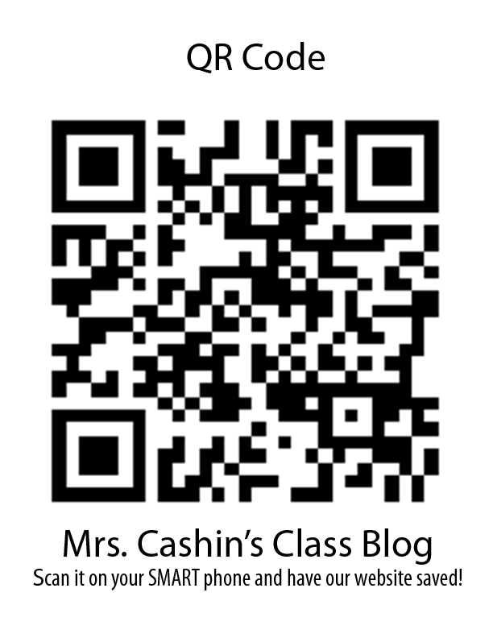

Slide 4

Contact Information
Email is the best way to contact me!
  acashin@questac.org
  Tutoring Hours: 3:00-3:30
  Mon: Mrs. Lindsey
  Tues: Ms. Blok
  Wed: Mrs. Cashin
  Thurs: Mrs. Hancock

Slide 5
Classroom Management/Discipline
Follow all school rules
Clip chart for behavioral management- Clip can move up or down

Slide 6
Homework
  You print out on Monday, return on Friday
  Or you may write out sorts homework on notebook paper and return
  No Homework the first few
  weeks of school.
  We will be practicing procedure and learning policy
  Read 20 minutes each night!

Slide 7
This is what the homework sheet looks like…
Weekly Homework
Reading: Read for 20 minutes each night
_____I read for 20 minutes each night.
Math: Practice your addition math facts (0-9) nightly
____I practiced my math facts nightly.
Spelling: Practice your Word Sorts and High Frequency Words
_____I practiced my spelling words.
Weekly Word Study Homework Schedule
Monday
Sort with an adult and explain this week’s rule.
Tuesday
Buddy sort words then put each column in ABC order. Have your buddy
Check the order. Then write the ABC order below.
Wednesday
Buddy sort then write the words in the writing sort on the back.
Thursday
Choose 5 of this week’s word study words. Write each word in a complete
sentence. Underline each word in the sentence.

Slide 8
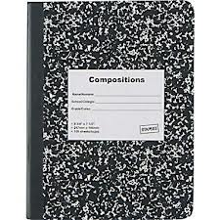
Poetry/Letters Home Notebook
Each week we will have the opportunity to add to a poetry book. A drawing lesson will be incorporated into the poetry lesson. We want to share this with you each week, therefore your child will bring this home each Friday along with a “letter home” explaining all they have learned for the current week. Please take the time to see what they have written you and give them a brief reply back. When they return it on Monday, with a response from you, I will add a fun sticker to the cover of the book. We want our books to be completely covered with stickers by the end of the year, so please help your child in participating in this fun activity.

Slide 9

Grading
I Will update SIS weekly
Not all work will be graded, we do a lot of practice in second grade
Word Study, instead of “Spelling Tests”
  We will be practicing word patterns to help students become life-long spellers!

Slide 10

Parent Email- Please write an updated email address for me.
Student spotlight: Sign up for your child’s week
Volunteers: We love to have you volunteer in our classroom, please sign up for what you can!
On the Back Table!

Slide 11


First day of school information
Tell your child how they will be going home (daycare van, parent/guardian pickup)
I will be standing right outside our classroom window during pick-up time
Bring student supplies on Monday!
Parents may help students to the room
and say their goodbyes here!

Slide 12
Things to return on Monday!
Classroom disclosure agreement
Acceptable Use Policy
  Or sign it tonight and leave it with me!
Student Information Packet
  Or Fill it out tonight and leave it with me!

Slide 13
If you brought school supplies tonight, follow the directions written on the board.

Slide 14

We will have a fantastic school year!
See you on Monday!!

