Slide 1

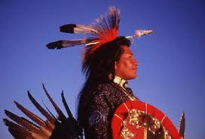

Navajo Indians
By: Jacob Kelley

Slide 2

Table Of Contents
Slide 1 cover
Slide 2 table of contents
Slide 3 tribe traditions
Slide 4 what did they eat
Slide 5 where did they live
Slide 6 how did they dress
Slide 7 famous people
Slide 8 contribution
Slide 9 how big is the tribe
Slide 10 extra information about the tribe
Slide 11 quiz for audience
Slide 12 websites used for research
Slide 13 about the author

Slide 3
Tribe traditions
Navajo Indian families are matriarehal meaning that a woman, usually the grandma is in charge of the house.
The typical traditional house is called a Hogan.
Many families live outdoors during the summers since the Navajo homeland is mostly desert.

Slide 4

What Navajos ate
Sheep became an important source of food. The Navajo were mainly farmers and ranchers. They also hunted some fish, ducks and other water birds.

Slide 5
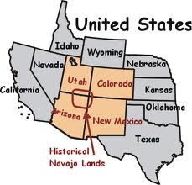
Where Navajo Indians lived
They lived in dry places with very little rain. The Navajo Indians are natives of the four corner region. The Navajo are still living in their traditional territory today.

Slide 6
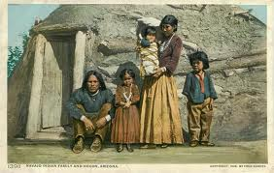
How Navajo Indians dressed
A black hat became very popular for Navajo men. Both men and women wore silver and turquoise jewelry. Women favored colorful blouses, wile men wore jeans boots and colorful shirts.

Slide 7
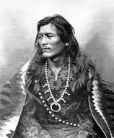
Famous people
A leader named Haashkeneinii helped a group escape from a march that killed a lot of Navajo Indians. Some other Navajo leaders are hoskaninni, and baililii. There were many more Navajo Indian leaders, but I don’t want to name all of them.

Slide 8
contributions
We used their language to talk to people in war so spies don’t know what we said. These people were called code talkers.
We learned about the Navajo history from some Indians.
We learned some patterns in Navajo clothing.

Slide 9

how big their tribe was
Seven thousand members lived in Utah. About 250,000 people make op the Navajo tribe. That is a lot of people.

Slide 10
Extra information about the tribe
They had to dig a stream to their crops to water them because they lived in dry places. They shared a lot of food and stuff. They were very friendly.

Slide 11

Quiz for audience
What was their traditional house called?
What did they eat other then fish?
Where did their tribe mainly live?
Hogan
Ducks and other water birds.
The four corner region.

Slide 12
Websites used for research
History For kids. www.historyforkids.com
Navajo Indians. www.NavajoIndians.com
Utah history to go. www.Utahhistorytogo.com

Slide 13
About the author
Where do I live? Roy Utah.
What is My favorite book? I don’t have one.
What are my favorite activity? Practice soccer with my friends.
What you should know about me is that I like math more than any other subject in school.
I can help others by not being mean and making them feel bad.

