Slide 1
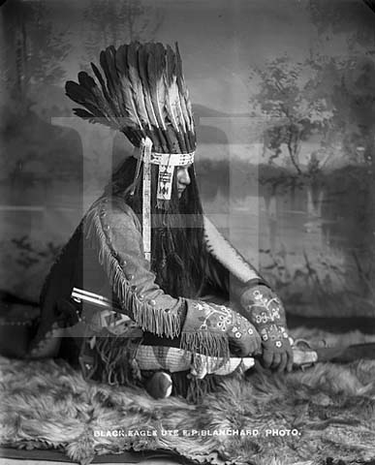

The History of the Ute Indians
By: Emma Medell

Slide 2
Table of contents
Traditions
What did they eat
Where did they live
How did they dress
Famous People
Contributions
How big is the tribe
Extra info about the tribe
Quiz for audience
Websites I used for research
About me

Slide 3
Traditions
They lived in a nomadic way
Considered the land to be full of spirits and powers
They lived in tepees made from elk or deer hides

Slide 4
What did they eat?
The Ute’s sometime grew small gardens near spring. They hunted deer to use for food ,leather, and tools. They also hunted big horn sheep, wild turkeys, badgers, beavers, rabbits, fish, and more. They ate plants such as yucca fruit, rice grass, pine nuts, chokecherries, and wild onions.

Slide 5
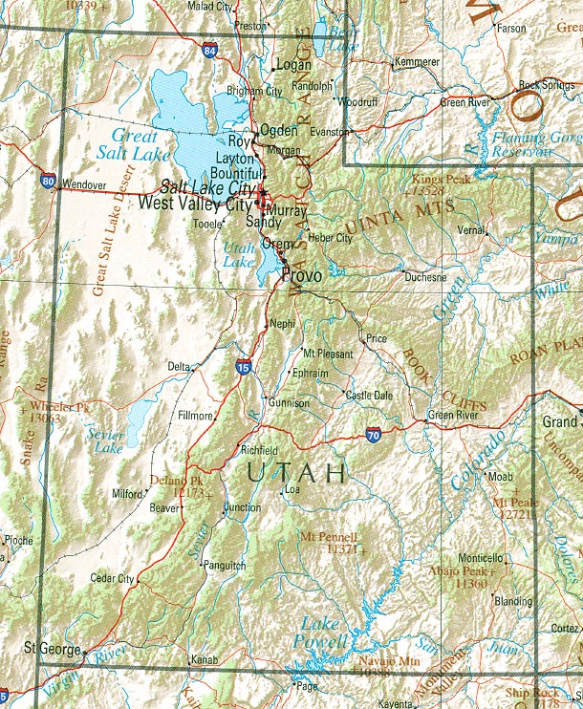
Where did they live?
The Ute's lived in the eastern and central part of Utah. They also lived in parts of Colorado, Wyoming, and New Mexico. Two distinct groups of the Ute's lived in Utah, they were the Northern Ute's and the White Mesa Ute's. In historic times, at least two different bands of Ute’s lived in Utah.

Slide 6
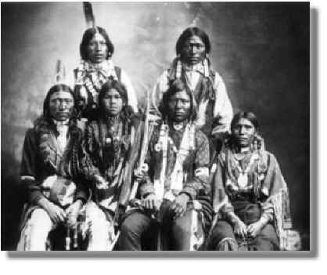
How did they dress?
The Ute’s made there clothes out of plants and animals. What they didn’t eat, they make it in to clothes. The men wore buffalo sinks. The women wore dresses and leggings.

Slide 7
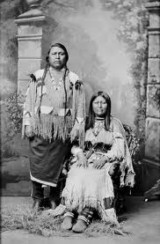
Famous People
Their was a chief named Black Hawk. He was born in spring, Lake Villa. He died in September 26th, 1870. Also there was this chief named Aoray. He was born in 1833. He died in 1880. He was 53 when he died.

Slide 8
Contributions
They got there name from our state
Black Hawk is a name of a helicopter
The Ute’s tote the pioneers how to live

Slide 9
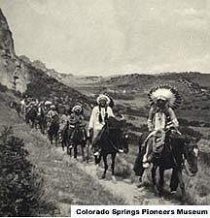
How big is the tribe?
There is a lot of Ute’s that lived. Eleven bands of Ute’s lived in Utah. Each band claimed its own territory. Some bands led and traded together.

Slide 10
Extra info about the tribe.
In the 1930s, Tu-Cu-Pit saw the Mormon pioneers enter the Salt Lake Valley in 1847.

Slide 11
Quiz for audience.
Did they live in a nomadic way?
Did they have animals?
Did they live in groups?

Slide 12
Websites I used for research:
Title of page: I love history website address: www. I love history. Com
Title of page: Google images website address: www. Google images. Com

Slide 13
About Me!!!
I live in Roy Utah
Little House in the Big Woods
I like dancing and art
I have a dog
To see what they need and I can help

