Slide 1
Back to School!
Miss Waddell

Slide 2
A Little About Me
I grew up in South Carolina with one brother.
This will be my 14th year teaching. I came from Ogden City School District. Its my 4th year here at Quest.
I taught 3 years in kindergarten, 6 years in 2^{nd,} and 3 years in 3rd grade.
I think 3rd grade is the best grade to teach!
The beach/tropical places bring me happiness! ☺
I love reading, working out, and spending time outside.

Slide 3
3rd Grade
3rd grade will be a very fun grade. I try to make every day enjoyable for the students.
Things to look forward to…
Money System/School Store
Musical in the Spring
Fun Art Projects EVERY WEEK!!
Lots of interesting ways to learn through using technology!!!

Slide 4
Fluency Goals this Year
Every student reading 110 words per minute by the end of the year.
Every student mentally recalls addition and subtraction facts by the end of October.
Multiplication and division facts throughout the year.

Slide 5
Money System
It focuses on guiding student’s behavior with positive reinforcement all while learning how to count and earn money.
I will do my best to create a positive learning environment where students feel safe.
I implement the Money System in the classroom that encourages the students to be responsible in the classroom. They are paid for many things: jobs, on time, 90% or better, etc… Students pay me for other things: being tardy, late homework, restroom during class time, etc… Students learn responsibility through becoming more familiar with counting money. On Fridays, the students get to go to the classroom School Store and spend their hard earned money! ☺

Slide 6
How to get a hold of me:
Email me at ewaddell@questac.org (BEST way to contact me!)
Call the office at 801-731-9859 ext. 132
Comment on the classroom blog.
I won’t usually answer the phone during school because I am teaching, but please leave a message. I will call you back as soon as I can before or after school.

Slide 7
To Be Done at HOME…
**CHANGES WITH SPELLING THIS YEAR!!**
-Weekly Homework posted on the blog
-20 minutes of reading a night
-Monthly Poems (sent home & posted on blog)
-Great Brain Book Reports

Slide 8
Tutoring
Students are invited to 3rd Grade after-school tutoring from 3:00-3:30 (Monday-Thursday).
I will contact you if your child could benefit from tutoring at various times of the year.

Slide 9
Bloomz
I will be using an app to help stay in contact. It is called Bloomz. Bloomz is a new app that works on both your smartphone as well as on your computer. You will receive quick updates and photos of class activities, be able to access your class calendar, and much more all in a private and secure environment.
Join using a web browser:
1. Go to bloomz.net and click “Join Bloomz”.
2. In the text box, enter M7HBBG.
3. Create your account.
Join using text messaging:
1. Text @M7HBBG to 1-858-BLOOMZ1 or 1-858-256-6691

Slide 10
Volunteering
All parents are welcome to volunteer in the classroom.
I know it is fun to see your student in the classroom setting. I love having parental involvement in the classroom.
Spelling Tests on Friday
School Store (Fridays @ 2:00)
Art Books (spring)
Sight word helper (twice a week)
Classroom Parties/Field trips

Slide 11
Homework Packet
I will post homework for the week on Monday.
You are responsible for printing homework and reading minutes off and completing them at home. Please write anything down on paper you can’t print.
It is due the next Friday morning. Please help your child to be responsible for getting it to school on time.
Reading Minutes and homework are a grade.

Slide 12
Blog Address
www.qacblogs.org/erica.waddell
Please subscribe ASAP. You MUST follow up and follow the directions on the email you receive after subscription. You can subscribe tonight at the back table.
Please print off Disclosure statement, read closely, sign, and return to school.

Slide 13
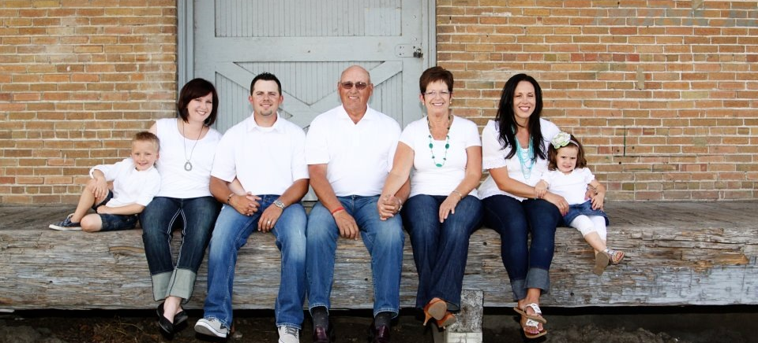
My Family

Slide 14
Questions?

Slide 15
Let’s Have a Great Year!

