Slide 1
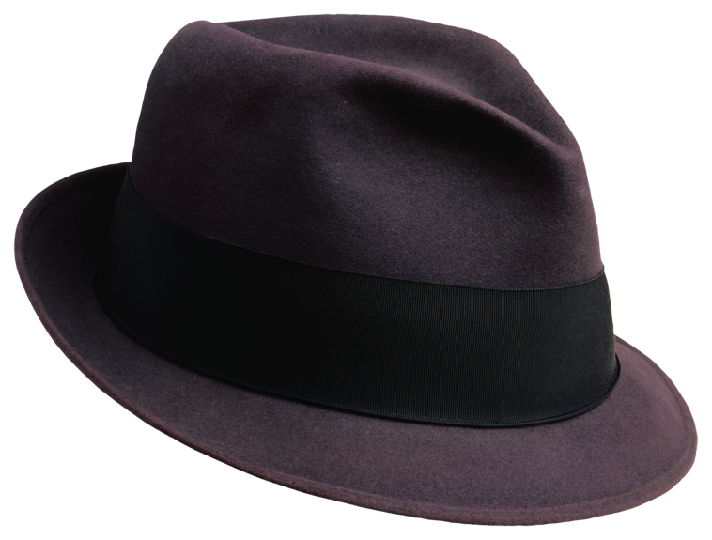
Feature Stories
Journalism I

Slide 2
What Are Feature Stories?
Feature stories are human-interest articles that focus on particular people, places and events.
Feature stories are journalistic, researched, descriptive, colorful, thoughtful, reflective, thorough writing about original ideas.
Feature stories cover topics in depth, going further than mere hard news coverage by amplifying and explaining the most interesting and important elements of a situation or occurrence.
Feature stories are popular content elements of newspapers, magazines, blogs, websites, newsletters, television broadcasts and other mass media.

Slide 3
What Are Feature Stories?
While journalists reporting late-breaking hard news don't have enough preparation time and copy length to include much background and description, writers of features have the space and time to evoke imagery in their stories and fill in details of the circumstances and atmosphere.

Slide 4
What Are Feature Stories?
A feature story is not meant to report the latest breaking news, but rather an in-depth look at a subject.
Feature articles range from the news feature that provides sidebar background to a current event hard news story, to a relatively timeless story that has natural human interest.
Features generally are longer than hard-news articles because the feature penetrates deeper into its subject, expanding on the details rather than trying to concentrate on a few important key points.
In hard news stories, often referred to as inverted pyramid style, the reporter makes the point, sets the tone, and frames the issue in the first paragraph or two.
In a feature story, on the other hand, the writer has the time and space to develop the theme, but sometimes postpones the main point until the end. The whole story does not have to be encapsulated in the lead.

Slide 5
Typical types
There are many kinds of feature stories. Here are some popular types:
Human Interest: The best-known kind of feature story is the human-interest story that discusses issues through the experiences of another.
Profiles: A very common type of feature is the profile that reveals an individual's character and lifestyle. The profile exposes different facets of the subject so readers will feel they know the person.
How-To: These articles help people learn by telling them how to do something. The writer learns about the topic through education, experience, research or interviews with experts.

Slide 6
Typical types
Historical Features: These features commemorate important dates in history or turning points in our social, political and cultural development. They offer a useful juxtaposition of then and now. Historical features take the reader back to revisit an event and issues surrounding it. A variation is the this date in history short feature, which reminds people of significant events on a particular date. Seasonal Themes: Stories about holidays and the change of seasons address matters at specific times of a year. For instance, they cover life milestones, social, political and cultural cycles, and business cycles. Behind the Scenes: Inside views of unusual occupations, issues, and events give readers a feeling of penetrating the inner circle or being a mouse in a corner. Readers like feeling privy to unusual details and well kept secrets about procedures or activities they might not ordinarily be exposed to or allowed to participate in.

Slide 7
Non-fiction stories
Feature stories are journalistic reports. They are not opinion essays or editorials. They should not be confused with creative writing or works of fiction.
The writer's opinions and attitudes are not important to the story.
The writer keeps herself or himself out of the story.
Writing in the third person helps maintain the necessary distance.

Slide 8
Telling stories
Hard news stories report very timely events that have just occurred. Feature stories, on the other hand, are soft news because they are not as timely, not as swiftly reported. Feature writers have the extra time to complete background research, interviews and observation for their stories.

Slide 9
Telling stories
Here are some suggestions for polishing feature writing skills and developing an eye for feature story ideas.
Feature stories give readers information in a pleasing, entertaining format that highlights an issue by describing the people, places, events and ideas that shape it.
Feature stories are really more like nonfiction short stories than hard news stories.
While there should a news peg for the existence of a story at a particular time, the immediacy of the event is secondary in a feature story. In fact, sometimes there is no immediate event.
The power of a feature story lies in its ability to amplify the focus on an issue through first-rate story telling, irony, humor, human appeal, atmosphere and colorful details.
Features have a clear beginning, middle and end and are longer than hard-news stories.

Slide 10
Gathering data
Journalists use three tools to gather information for stories: observation, interview and background research. After completing these, the writer brings the story to life through colorful description, meaningful anecdotes and significant quotes.
These elements are obtained when interviewing and observing by jotting down everything encountered – smells, noises, colors, textures, emotions, details seen and heard in the surroundings.
The journalist keeps an open mind while interviewing subjects and researching sources.
The writer avoids steering the story or imposing personal ideas on the sources.
The writer avoids deciding on the theme of the story until sufficient information has been gathered to show a direction or point of view.

Slide 11
Story format
The information in a feature is organized differently from hard news stories. Sometimes a writer uses several paragraphs of copy at the outset to engage the reader before getting on with the main elements of the story. After the title and opening paragraph grab a reader, narrative hooks are used to persuade the reader to continue reading. These hooks are attractive story elements such as action, mystery, drama or appealing characters intended to pull the reader forward through the story. They are complex narratives that come to life through colorful description, meaningful anecdotes and significant quotes.

Slide 12
Story format
In hard news stories, the reporter makes the point, sets the tone, and frames the issue in the first paragraph or two.
In feature stories, the whole story does not have to be encapsulated in an inverted pyramid lead. The writer can develop the storyline in a variety of ways and choose to postpone the main point until later in the copy or even the end.

Slide 13
Story format
A writer can choose to tell the story out of order to engage the reader's interest.
A story could begin with a dramatic moment and, once the reader is curious, the story could flash back to the history needed to understand it.
A story-within-a-story could be used with a narrator in the outer story telling the inner story to satisfy the curiosity of readers.
A storyline could alert readers that the story began in a way that seemed ordinary, but they must follow it to understand what happened eventually.
As with any news reporting, feature stories are subject to the journalistic standards of accuracy, fairness and precision. The quality of a story is judged on its content, organization and mechanics.

Slide 14
How long are these articles?
Newspaper features often are 500 to 2500 words in length.
Magazine features usually are 500 to 5,000 words.
Features on websites and blogs generally range from 250–2500 words, but hard drive space is relatively inexpensive so the length could vary dramatically through the use of non-linear hyperlinking of content.
Any medium might use a shorter or longer story than usual, depending on its perceived value.
Attention spans seem to grow ever shorter so brevity is valued. More than ever, all writing today needs to be clear and concise.

Slide 15
Illustrations
Every story is illustrated, usually with one or more photographs, but the art can be drawings, paintings, sketches, video or machinima, colorful graphs and charts, or other creative expressions depending on the medium for which the feature is packaged for dissemination.

Slide 16
Is this just for print journalists?
As newspapers and other print media face stiffer competition today from Internet news media, more feature stories are published because they can be more engaging to read. Wire services, such as the Associated Press and Reuters, which once distributed mostly hard news, now send feature stories to members. Public relations professionals frequently write feature articles. For instance, a company newsletter story profiling employees voluntarily helping the local community could benefit employees and their families as well as the firm's stockholders. Or a profile of a corporate CEO could be released to media when the firm makes news.

Slide 17
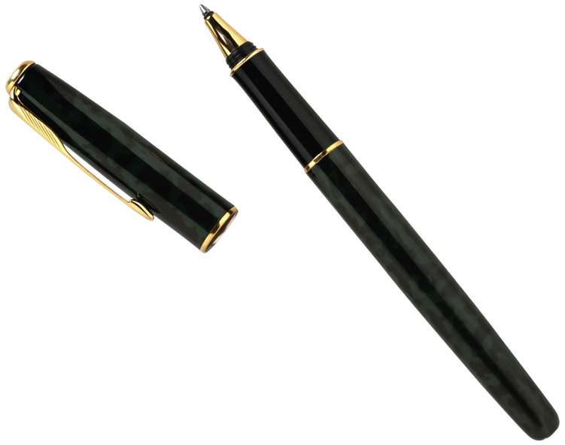
Is this just for print journalists?
Broadcast journalists use human interest stories, profiles, historical pieces, seasonal packages, behind the scenes revelations and even how-to descriptions. These can be seen and heard everywhere in television and radio news. A typical television news package includes an edited set of video clips for a story narrated by a reporter following a written script. Unlike a magazine article, for example, the TV feature story also will have audio, video, graphics and video effects. A news anchor with an over-the-shoulder graphic will be seen reading a lead-in introduction before the package is aired and concluding the story with additional information called a tag.

Slide 18
© 2011 Dr. Anthony Curtis, Mass Communication Dept., University of North Carolina at Pembroke 910.521.6616
The names Second Life and Linden Lab, and the hand logo and logotype, are registered trademarks of Linden Research Inc.

