Slide 1
Welcome to
Mrs. Peay’s Classroom

Slide 2
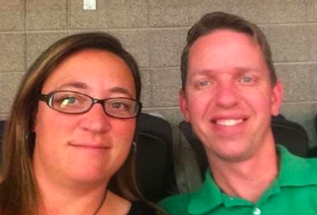
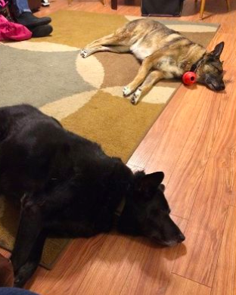
hello!
Basketball
Cross Country
Soccer

Slide 3
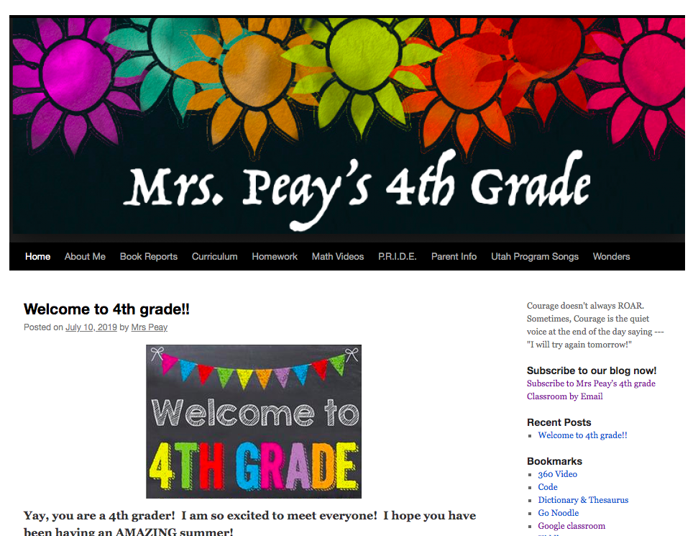
Subscribe to our blog
1.
1. Go to my blog qacblogs.org/trystal.peay
2. click “subscribe to our blog now “ on the right hand side.
3. Enter your email.
4. Don’t forget to confirm your subscription once it sends you an email.

Slide 4
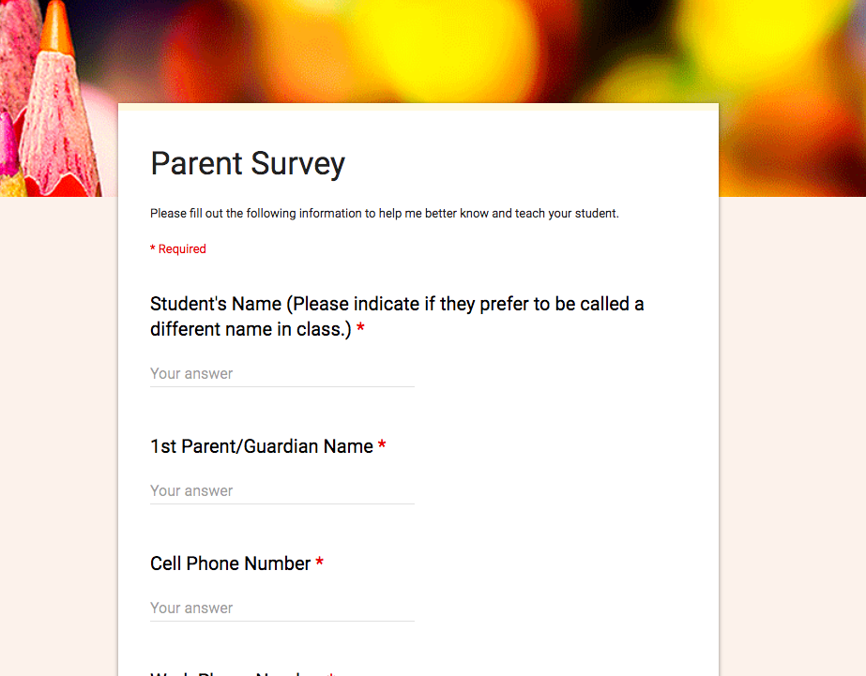
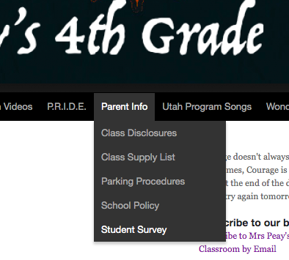
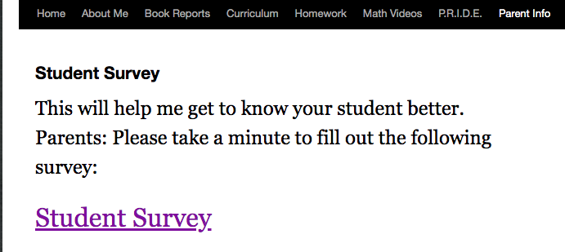
Student survey
2.
On my blog again go to parent info - student survey

Slide 5
Class disclosures
3.
Sign Me (Electronically)
Click Class Disclosures
Read Me
On My blog under Parent Info

Slide 6
Quest Grading Policy
How to Access Grades – (TeacherEase)
Gradebook (SIS) - Citizenship & Attendance
*You will receive an email that will include your access link.
2. You will see two scores.
One score for Citizenship Grade- P.R.I.D.E.
-Classroom work
-Classroom Participation
One score for Mastery/Proficiency Grade
Students grades are determined by student performance on various grade level assessments. Students are given multiple opportunities to demonstrate mastery and proficiency of standards.
For example, if a student receives a below proficiency score, he/she will not only be retaught, but will also have the opportunity to raise his/her score by retaking the assessment multiple times throughout the term.

Slide 7
Elementary Grading Scale
4 - 100%-90% The student demonstrates mastery of the standard (can apply and teach)
3 - 89%-80% The student demonstrates proficiency of the standard.
2 - 79%-60% The student is approaching proficiency.
1 - 59%-0% The student is well below proficiency.

Slide 8
Citizenship grading
P.R.I.D.E.
Personal Responsibility – Take charge of your learning
(minimal tardies and absences, being prepared, work completion,
minimal missing assignments, etc.)
Respect – Treat others the way you would like to be treated
(respect others , self, and property)
Integrity – Act with honesty in all you say and do
(speak the truth, no cheating, no plagiarism, etc.)
Discipline – Use self control to be your best
(no gum, be uniform compliant, follow school and class rules)
Engagement – Be an active learner
( participate in class, complete projects and work in groups)

Slide 9
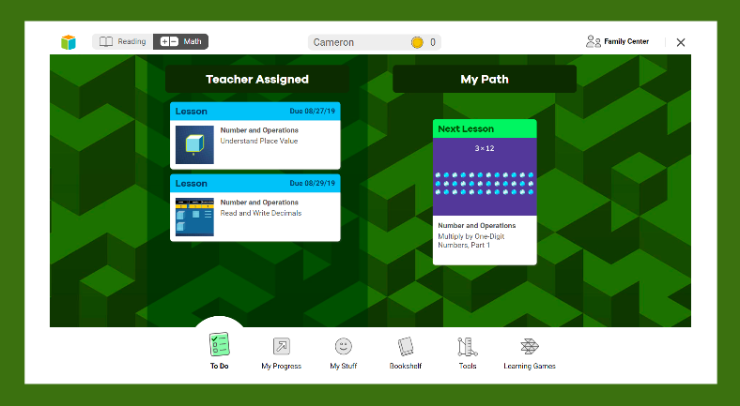
1- Students can log in at home.
2- Parents can see how to help their children with Math lessons.
NO it’s not ok….
To go into your students “MyPath”.
Yes it’s ok……
To go to teacher assigned lesson to work on at home.
To play learning games at home.
To go into “my stuff “ at home.

Slide 10
Parent Volunteers
I will also be communicating with parents through BLOOMZ.
Go to my blog for instructions on how to download.
I will be posting opportunities on our BLOG throughout the year to help in the classroom.
Class Parties
Field Trips
STEM Project help
Classroom Help in General
If you know you want to help in the classroom on a scheduled day and time. Please talk to me personally to set that up.

Slide 11
Each child will be celebrated on their birthday with a small gift from me.
(And maybe a funny song or two!)
We will celebrate your students birthday on their actual birthday unless it falls on a weekend. Then we will move it to the closest day we are in school.
If your students birthday falls during a summer month we will be celebrating their birthday during the month of May.
Class Birthdays
REMEMBER WE ARE A
NO FOOD/
NO TREAT SCHOOL!!

Slide 12
Just a heads up!
Book Reports
Presentation Due Dates:
First quarter: Week of October 21st
Second quarter: Week of January 13th
Third quarter: Week of March 9th
4th quarter: Week of May 11th
The book reports will be a specific genre:
First quarter: Choose Fantasy or Mystery
Second Quarter: Choose Historical Fiction or Nonfiction
Third Quarter: Choose Novel or Graphic Novel
Fourth Quarter: Biography or Autobiography
Additional info is on my blog under
Book Reports

Slide 13
Important Things to Remember
Our first week of school will be August 19-23. These will all be short days.
NEW THIS YEAR~Short days will now be dismissed at 1pm.
Bring Classroom supplies to the 1st day of school if you can.
Students:
Reflex - green light
20 min Reading a night
Come Monday ready to learn
Get excited for 4th grade. It’s going to be fantastic!
Parents:
Subscribe to our blog
Parent Survey
Class disclosures
Sign up on Bloomz

Slide 14
Title I Program
-This is a federally funded program based on the numbers of economically disadvantaged students at the school.
-Economically disadvantaged is determined by the free/reduced lunch population at the school.
-Quest is a “targeted assistance” school which means we receive money that must be spent ONLY on students targeted for help in reading and/or math
(Students who are served in these content areas do not need to qualify for free/reduced lunch).
-Quest Title 1 funds support our reading and math intervention programs.

Slide 15
Parents have the right to request and receive information on the qualifications of their child’s teacher.
If you would like this information, feel free to contact Dr. Dave at dbullock@questac.org or 801-731-9859.

Slide 17
thanks!
Any questions?
You can email me at tpeay@questac.org
Or call me here at 801-731-9859
Or message me on BLOOMZ
Presentation template by SlidesCarnival

